Slide 1

Leaders' School & College Chattogram
Class: VIII (Enlish Version)
L#01
Topic Name: Introduction to Python Programming
Md. Amin Kaiser
B.Sc. in CSE, DUET
Assistant Teacher(ICT)
E-mail: aminkaiser90@gmail.com

Slide 2
Contents
What is Programming?
What is Programming Language?
Why We Choose Python?
Creating Environment
Your First Python Program
How to Run Your Program
How Python Code is Executed
A Simple Test!
More About print()
Use of Escape Sequences
Comments on Python
Variables
Data Types

Slide 3
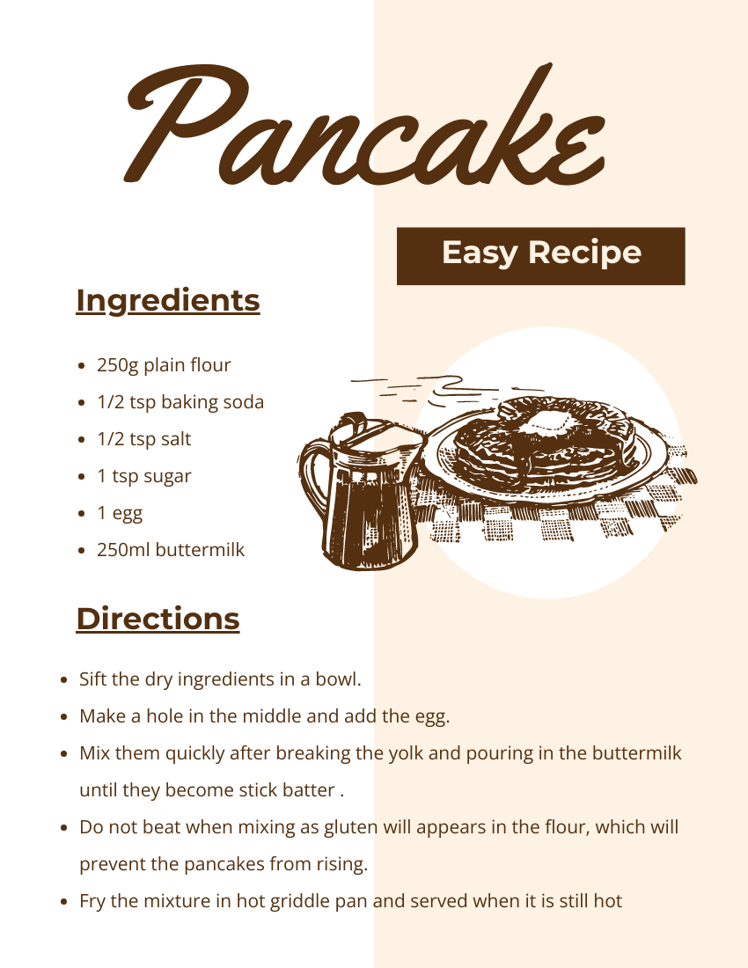
Have you Ever Made a Recipe?
We need to Follow some instructions!
Finally, we will be able to make a delicious item.

Slide 4

What is Programming?
Computer only understand 0 and 1
We need to give instructions to a computer on what to do
Program is a set of instructions to do a particular task

Slide 5

What is Programming Language?
We use language to communicate with each other
To communicate with computer: for giving instructions, we need to use a language
Python is one kind of Programming Language
C, C++, Java, C#, JavaScript etc.

Slide 6
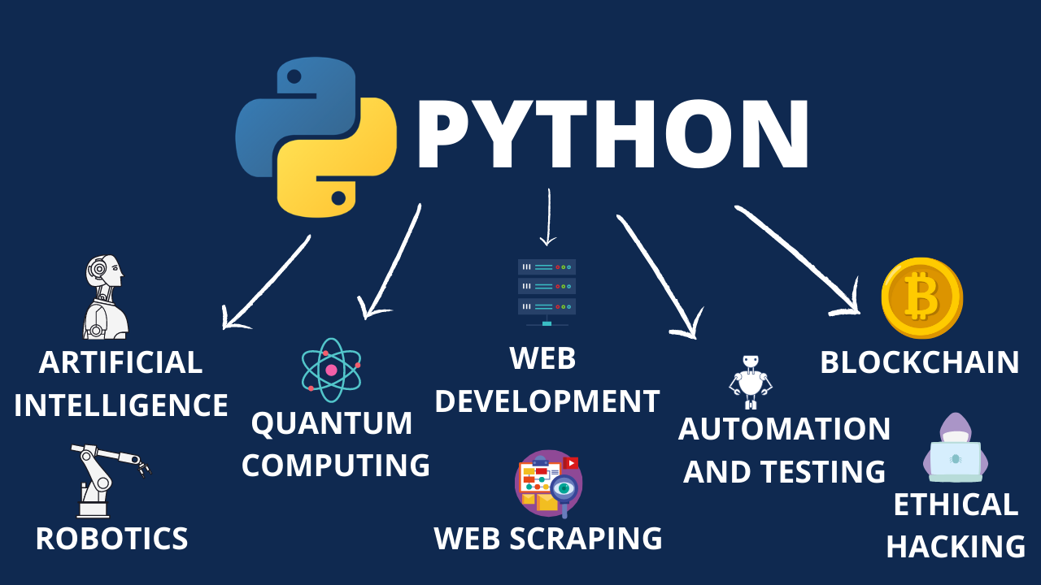
Why we choose Python?
Easy to learn and read
Versatile: Web Development, Data Analysis, Scientific Computing, Artificial Intelligence, Machine Learning, Automation

Slide 7
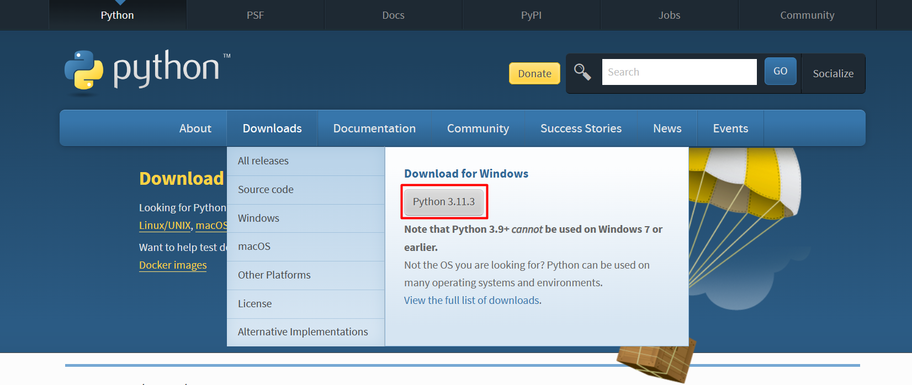
Creating Environment: Installing Python and PyCharm
To install Python: visit https://www.python.org/downloads/ -

Slide 8
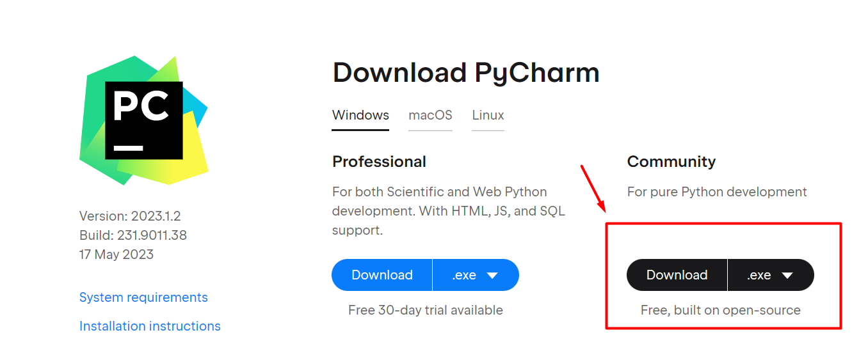
Creating Environment: Installing Python and PyCharm
To install PyCharm: visit https://www.jetbrains.com/pycharm/download/

Slide 9
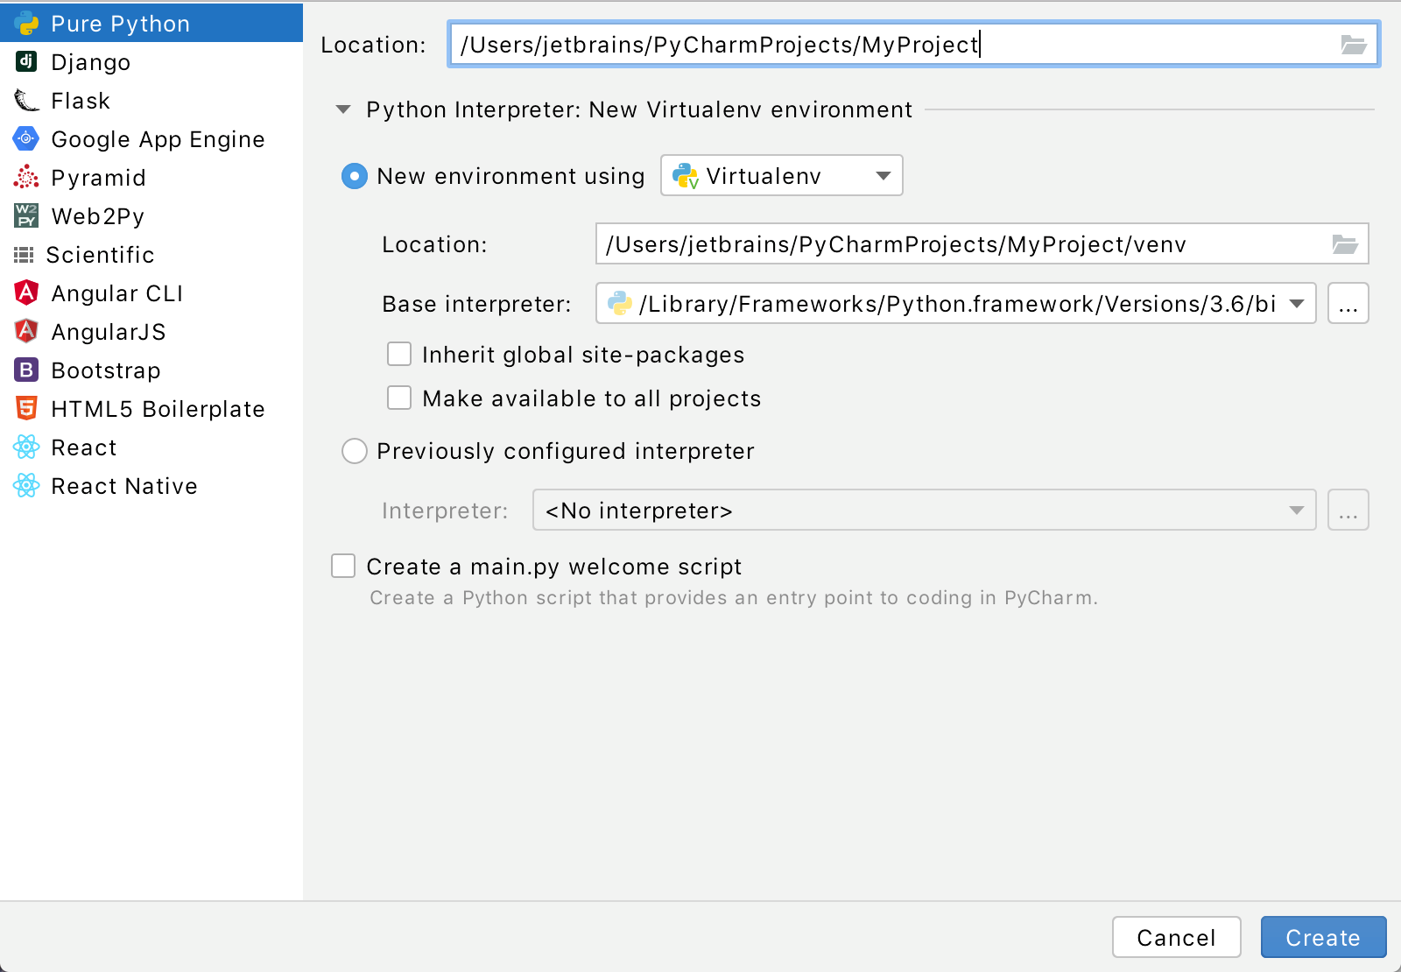
Creating Environment: Your First Python Project
If you’re on the Welcome screen, click New Project.
If you’ve already got any project open, choose File | New Project from the main menu.

Slide 10
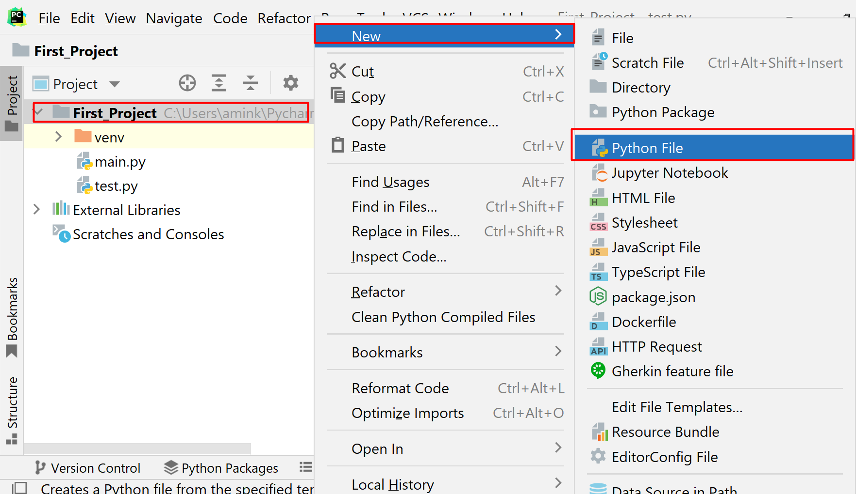
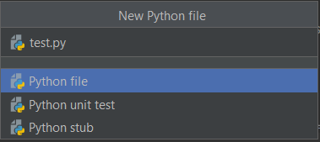
Creating Environment: Your First Python Project
In the Project tool window, select the project root (typically, it is the root node in the project tree), right-click it, and select File | New> Python File
Type a File name.py(test.py)

Slide 11
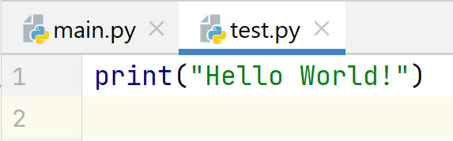
Your First Python Program: Print a Message!
print(“Your Message”)

Slide 12
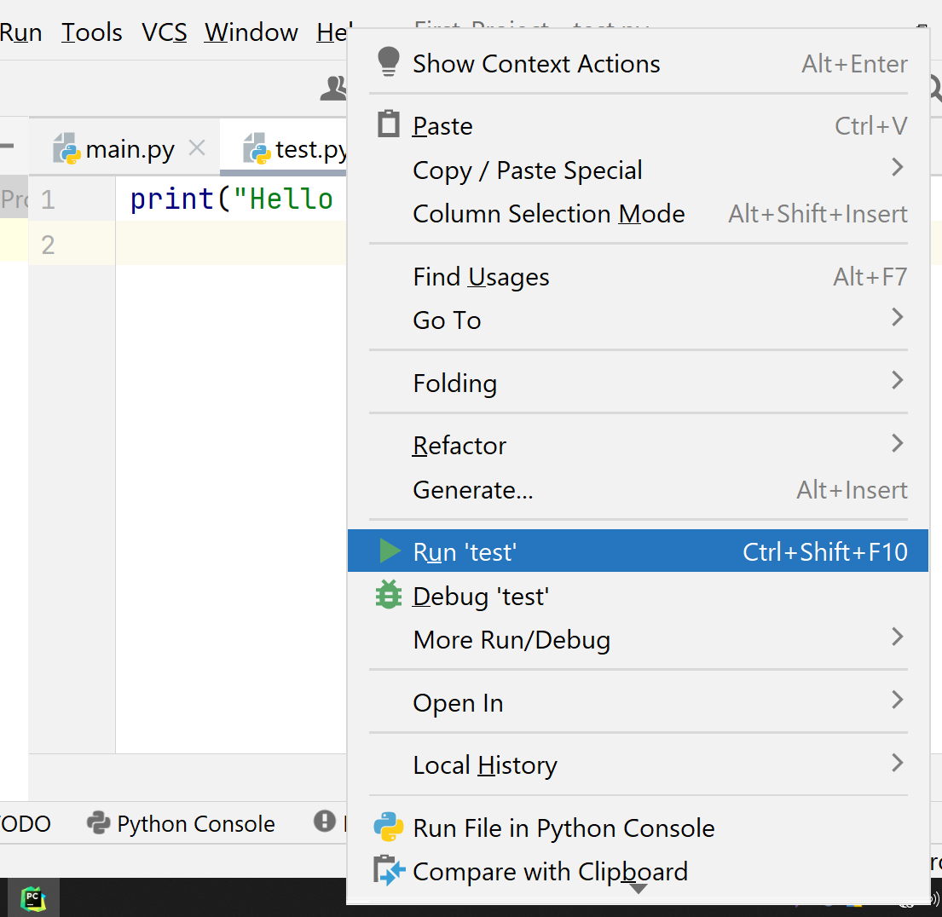
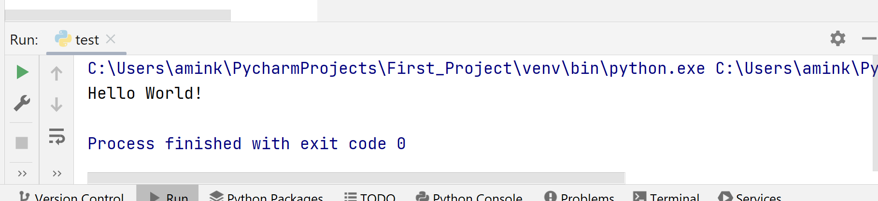
Run Your Program
Right-click the editor and select Run ‘test' from the context menu
Press Ctrl+Shift+F10
Since this Python script contains a main function, you can click an icon in the gutter.
Output:

Slide 13
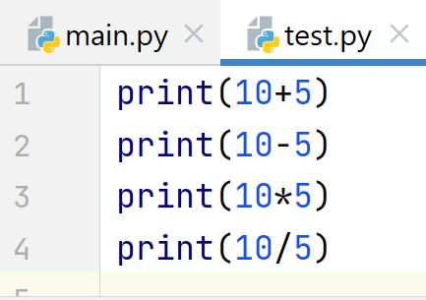
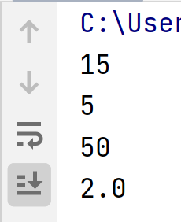
Mathematical Operations on print()
Output:

Slide 14
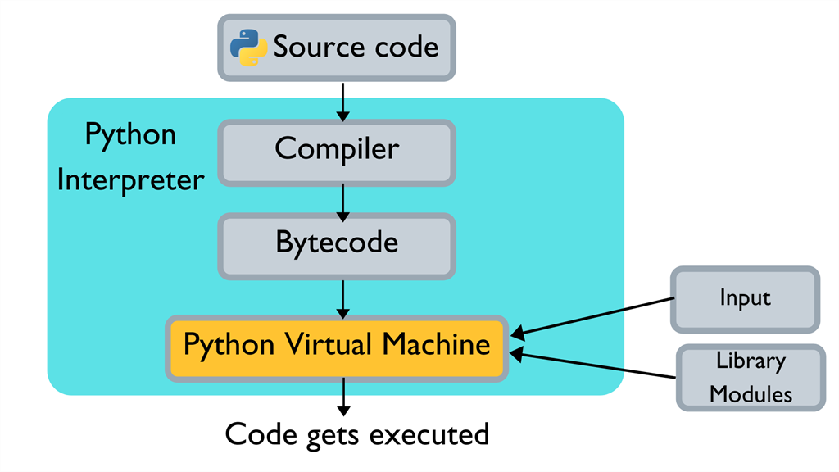
How Python Code is Executed?
We are writing our code that’s human-readable, but we know computers only understand 0/1. So how do computers understand our code?

Slide 15
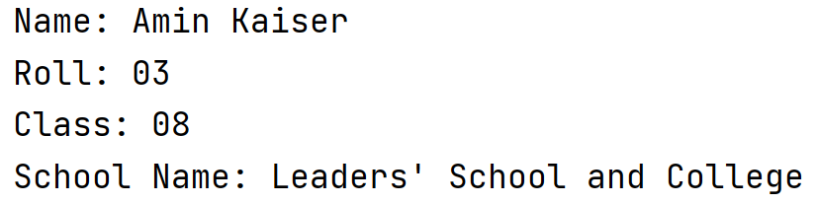
Test!
Print Your Name, Roll, Class, School Name on Output Screen

Slide 16
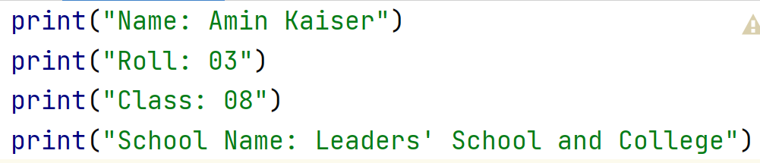
Solution!
Print Your Name, Roll, Class, School Name on Output Screen

Slide 17
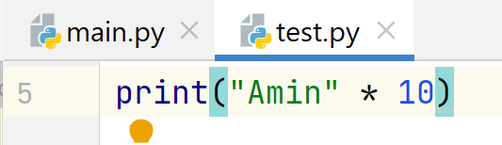
More About print()
10x Print Your Name: Simple Solution!
Output:

Slide 18

Escape Sequences
Escape sequences allow you to insert special characters in strings.
Put a backslash (\) before the character you want to escape.
\n: Newline
\t: Tab
\”: Double Quote
10x Print Your Name: Simple Solution!
Output:

Slide 19

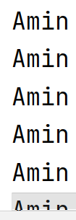
Escape Sequences: New Line
10x Print Your Name: Simple Solution!
Output:
…
…

Slide 20
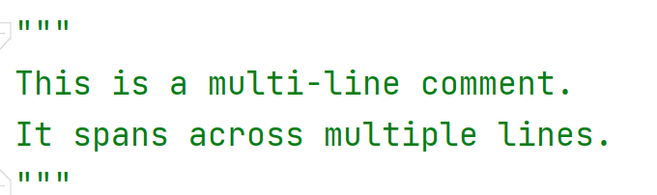
Comments on Python
Used to include explanatory or descriptive text within the code that is not executed as part of the program
They are intended to provide additional information to readers and developers of the code.
Single Line Comments: Start with #
Multi-line Comments:

Slide 21

Variables
Variables are used to store values in memory
Python does not require you to explicitly declare the data type of a variable.
When you assign a value to a variable, Python automatically assigns a data type based on the value.
You can assign a value to a variable using the assignment operator (=).
The general syntax is:
variable_name = value

Slide 22
Variables: Some Rules to Follow
Variable names must start with a letter or underscore (_), but not with a number.
Variable names can only contain letters, numbers, and underscores.
Variable names are case sensitive. For example, "myVar" and "myvar" are two different variables.
You cannot use reserved keywords as variable names, such as "if," "while," "for," "and," "or," "not," and "else.“
It's a good practice to use descriptive and meaningful variable names, so it's easy to understand the purpose of the variable.

Slide 23
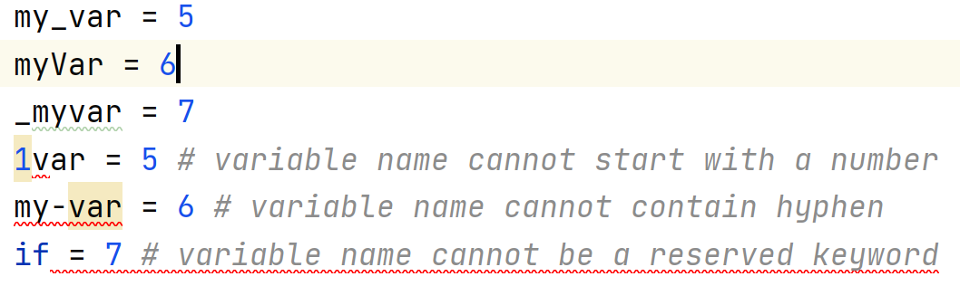
Variables: Some Rules to Follow

Slide 24
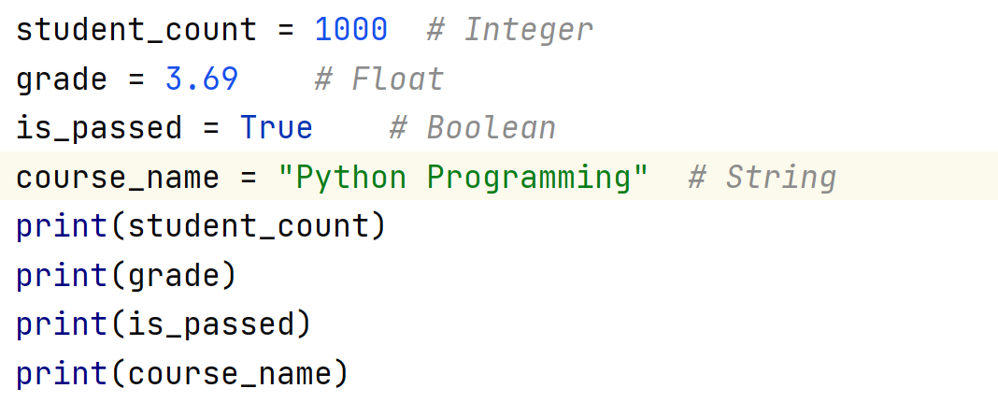
Data Types
Integer: Whole numbers without decimals (e.g., 5, -10).
Float: Real numbers with decimals (e.g., 3.14, -2.5).
String: A sequence of characters (e.g., "Hello", 'Python').
Boolean: Represents either True or False.

Slide 25
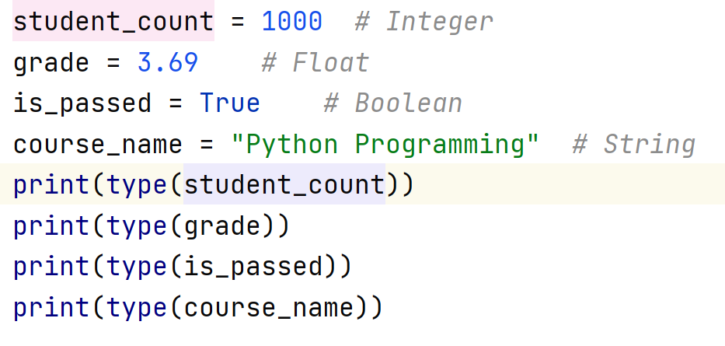
Check Data Type
type(): function is used to determine the type of an object.

Slide 26

Q/A Session

